Slide 1
Food origin – COOL labels for informed consumers
▸ Camille Perrin
Senior Food Policy Officer
Tuesday 4th November 2014
European Parliament
Primary Food Processors conference

Slide 2
Do EU consumers care about their food’s origin?
70% of consumers want to know where their food comes from.
*BEUC survey (2013) in AT, FR, PL & SW. Where does my food comes from?
71% of EU citizens say that
the origin of food is important.
*Special Eurobarometer No 389 (July 2012).
50% to 71% of consumers find it important that origin of staple foodstuffs (e.g. sugar, flour, vegetable oil) is labelled.
*BEUC survey (2013) in AT, FR, PL & SW. Where does my food comes from?
Origin ranks fifth to sixth
most important factor in consumer purchase decision (out of a list of 11).
*FCEC (2013), BEUC (2013).
69% of German consumers say they trust more food with COOL information.
*VZBV (2014) Survey carried out in the context of the project “Lebensmittelklarheit 2.0”

Slide 3
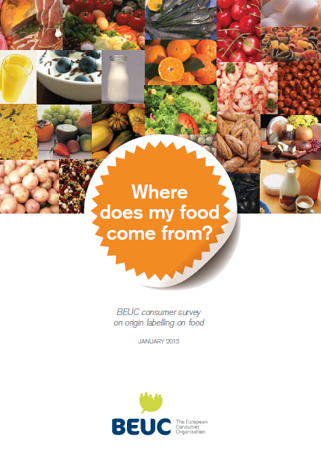
Why do consumers want to know their food’s origin?
BEUC survey Where does my food come from?
Field work in July 2012 (AT, FR, PL and SW) for publication in January 2013
Similar studies by BEUC members (BE, IT, ES, PT, DK, EL, CZ)
Multiple reasons:
quality/characteristics
environmental impact
safety
ethical concerns (e.g. labour rights, animal welfare)
support local/national farming/economy
BEUC research carried out before recent fraud scandals that have further reinforced consumers’ interest in where and how food is produced.

Slide 4
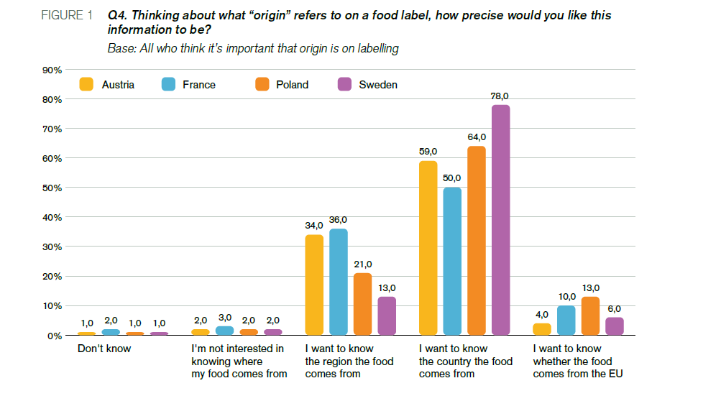
What type of origin information? Geographical level
Source: BEUC (2013) Where does my food come from?

Slide 5
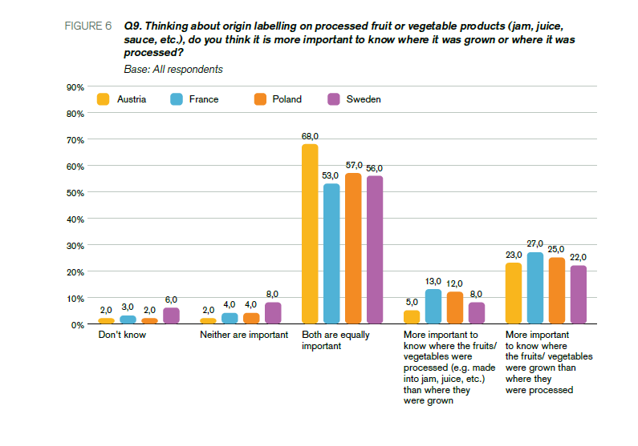
What type of origin information? Place of farming vs. place of last substantial transformation (I)
Source: BEUC (2013) Where does my food come from?

Slide 6
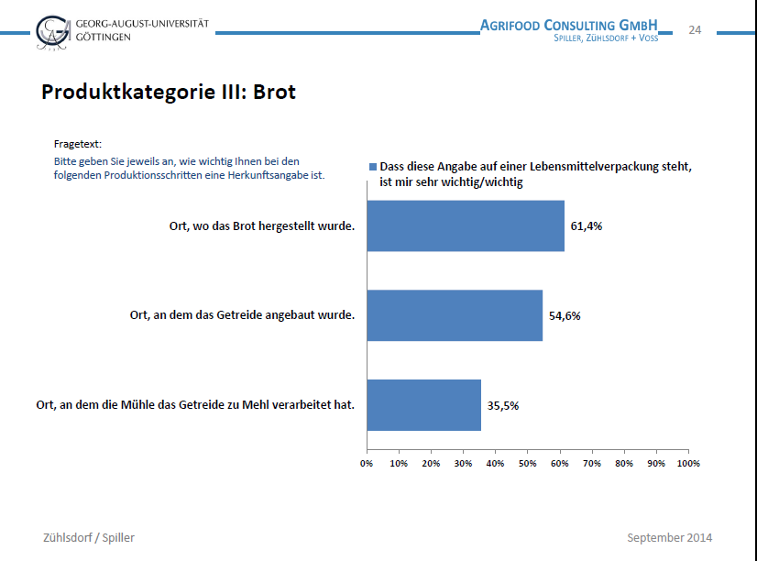
What type of origin information? Place of farming vs. place of last substantial transformation (II)
Source: Verbraucherzentrale Bundesverband (2014) Survey carried out in the context of the project Lebensmittelklarheit 2.0

Slide 7
COOL for unprocessed foods, single-ingredient foods and ingredients representing >50%
We hear:
“Unpractical”
“Too costly”
“Will disrupt trade and the internal market”
“Of little value to consumers, who are not willing to pay”
“Will increase environmental footprint of food products”
… STILL

Slide 9
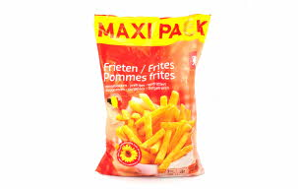
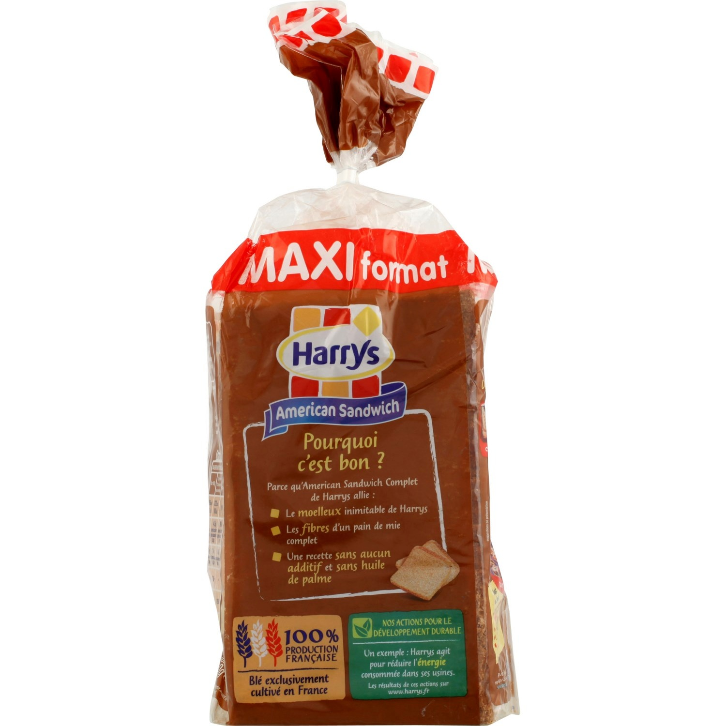
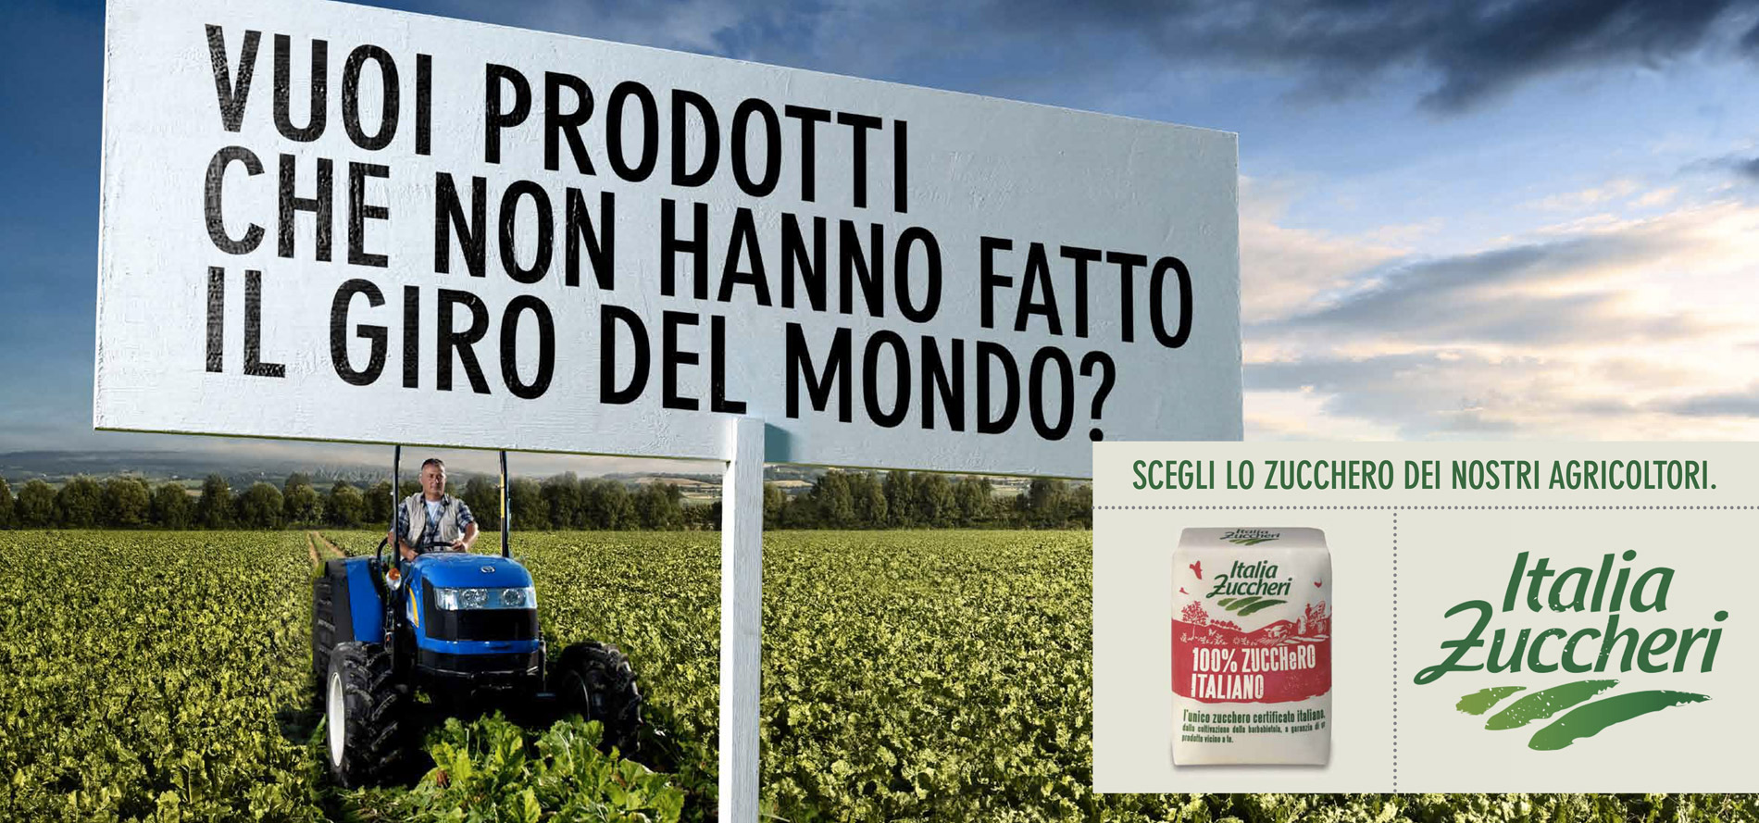

Slide 10
BEUC recommendations
Robust, verifiable data needed to inform policy decision
Sectoral approach?
Consumers’ interest in COOL cannot be assessed solely in terms of ‘willingness to pay’
Many consumers do simply not conceive of having to pay to have access to such basic food information as the origin!
Strong rules needed on voluntary COOL
Implementing act? (legal deadline: Dec. 2013)
Place of FARMING of the primary ingredient(s) should be labelled (not just the country of processing)
For consistency, same geographical level of precision as for the food (i.e. COUNTRY level)
Costs not a valid argument as possibility to just indicate the primary ingredient(s) has a “different origin”
→ Status quo is no option for consumers

Slide 11
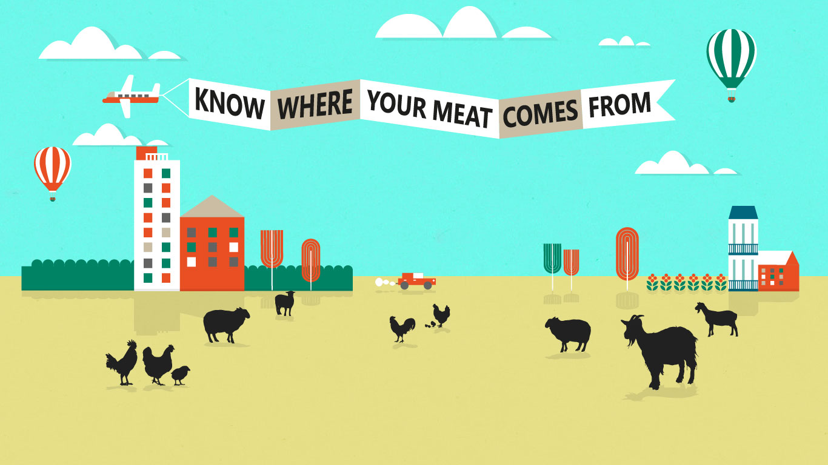
BEUC campaign: Where is my meat from? (I)
Social media campaign launched simultaneously (2nd Sept.) in 13 EU Member States*, Norway & Switzerland.
www.whereismymeatfrom.eu
* AT, BE, CY, DE, DK, EL, ES, FR, IT, PL, PT, SW, UK.
EU consumers want to know where their food comes from - especially their meat.
Embark on a pig’s journey from farm to fork and see how inadequate origin labels are.
Join the BEUC campaign for a more transparent meat supply chain: www.beuc.eu/can-we-trust-our-meat

Slide 12
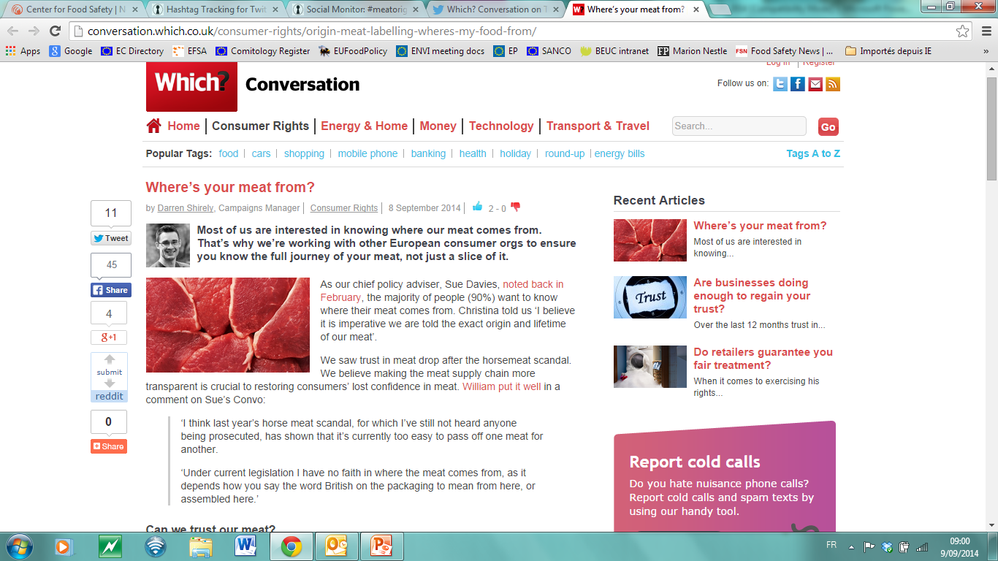
BEUC campaign: Where is my meat from? (II)

Slide 13
www.beuc.eu – food@beuc.eu

